Slide 1
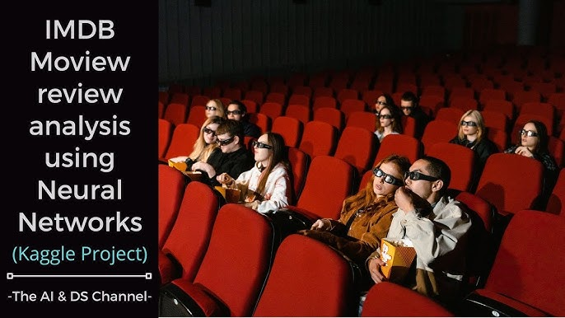

Slide 2

Number | Name
1 | Rana Yasser Anter
2 | Youssef Mohamed
3 | Youssef Magdy
4 | Ahmed Rabie
5 | Youssef Tarek
6 | Hazem Mohamed

Slide 3
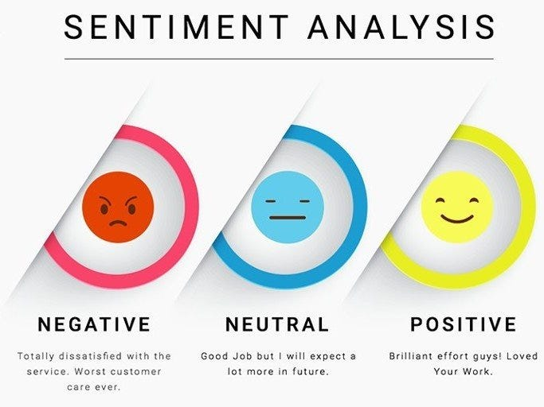
📌 Project Description
This project is a **Sentiment Analysis** task on the famous **IMDB Movie Reviews Dataset** 🎥🍿.
The main goal is to build a pipeline that can **analyze movie reviews** and classify them into **positive 😊** or **negative 😞** sentiments.
By using **NLP techniques**, text preprocessing, and machine learning models, we explored how artificial intelligence can understand emotions from text.

Slide 4

Project Overview What is this project about? 📌 This project focuses on analyzing IMDB movie reviews to classify them as positive or negative using Natural Language Processing (NLP). 🎯 Goal: To build a machine learning model that understands people’s opinions about movies.

Slide 5
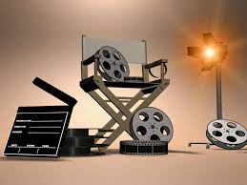
Objectives
Objectives 🎯 Project Objectives: 📥 Load and explore IMDB dataset. 🧹 Apply text preprocessing (cleaning, tokenization, stopwords removal). 📊 Perform data visualization to understand the dataset. 🤖 Train multiple ML models (Naïve Bayes, Logistic Regression, Random Forest). ✅ Evaluate models and com

Slide 6

🟦 Dataset Description 📂 Dataset: IMDB Movie Reviews 💾 Size: 50,000 reviews 🔖 Labels: Positive / Negative 📍 Source: Kaggle

Slide 7
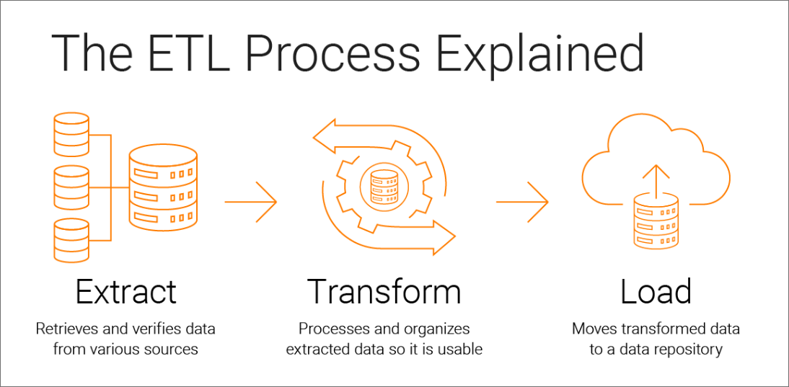
🟦 Preprocessing (Generic) 🧹 Generic Preprocessing Steps: 🔡 Lowercasing ✂️ Removing punctuation 🛑 Removing stopwords 🎭 Lemmatization/Stemming 📌 Example: "The movie was AMAZING!!! 🤩" → "movie amazing"

Slide 8
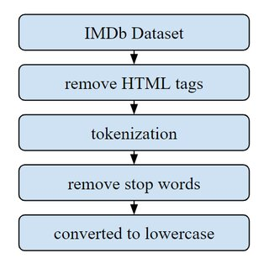
🟦: Preprocessing (IMDB-specific) 🛠️ IMDB-specific Preprocessing: Remove HTML tags 🏷️ Replace contractions (don’t → do not) Handle emoticons 🙂🙁 📊 This helps clean the reviews more effectively.

Slide 9
Data Visualization
Visualizations Used:
Word Clouds ☁️
Bar charts of most common words 📊
Pie chart of positive vs. negative reviews 🥧

Slide 10
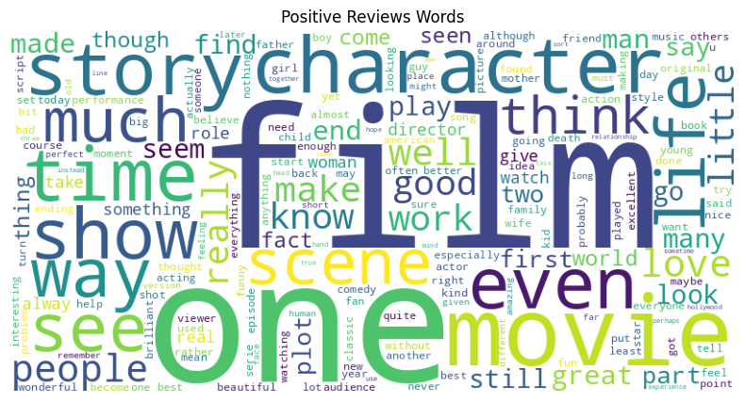
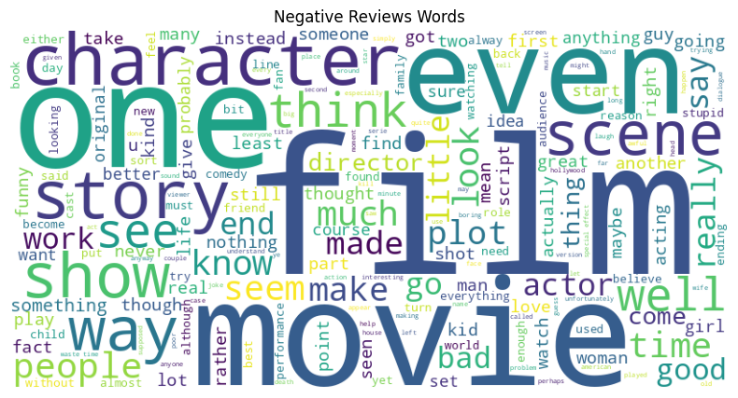

Slide 11

Machine Learning Models
🤖 Models Trained:
🧮 Naïve Bayes
📈 Logistic Regression
🌳 Random Forest
Each model was trained on the cleaned datase

Slide 12
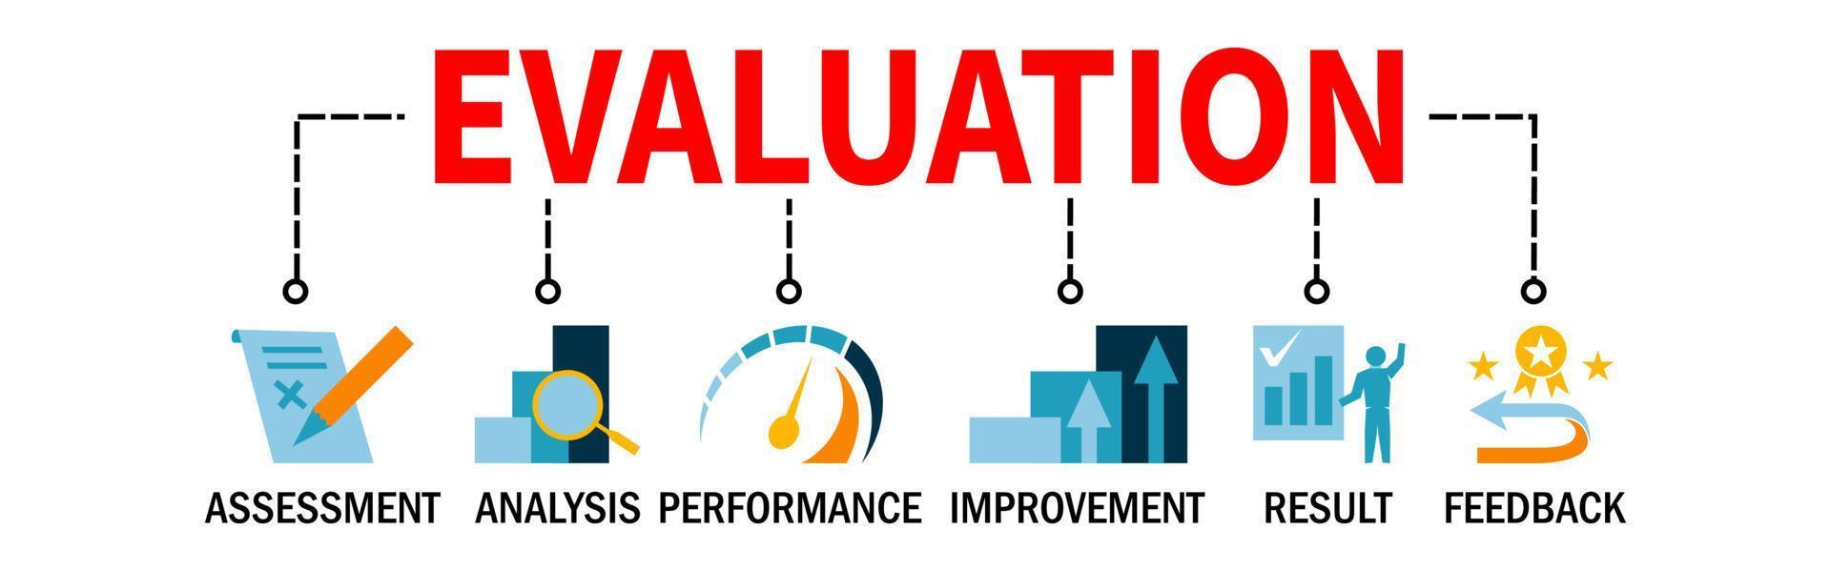
Results & Evaluation
Results & Evaluation
📊 Model Accuracy:
Naïve Bayes: ~82% ✅
Logistic Regression: ~86% 🚀
Random Forest: ~84% 🌳
🏆 Best Model → Logistic Regression

Slide 13

Conclusion
✅ Sentiment analysis helps understand people’s opinions.
✅ Logistic Regression performed the best on IMDB dataset.
✅ Project shows how NLP + ML can analyze movie reviews 🎬

Slide 14


